Slide 1
Artificial Neural Networks - Continued
Dr Farhan Hassan Khan
Machine Learning

Slide 2
Feedforward Neural Networks
Also called
Deep Feedforward Network
Multi-Layer Perceptrons (MLPs)
These models are called feedforward because information ﬂows from input x, through the intermediate computations, and ﬁnally to the output y.
There are no feedback connections in which outputs of the model are fed back into itself.
Convolutional Neural Networks (CNN) used for object recognition from photos are a specialized kind of feedforward network.
When feedforward neural networks are extended to include feedback connections, they are called Recurrent Neural Networks (RNN).

Slide 3
“Deep” Learning
Feedforward neural networks are called networks because they are typically represented by composing together many diﬀerent functions.
For example, we might have three functions f1,f2, and f3 connected in a chain, to form y = f(x) = f3( f2 ( f1(x) ) ).
In this case, f1 is called the ﬁrst layer of the network, f2 is called the second layer, and so on.
Overall length of the chain gives the depth of the model. The name “deep learning” arose from this terminology.
The ﬁnal layer of a feedforward network is called the output layer

Slide 4
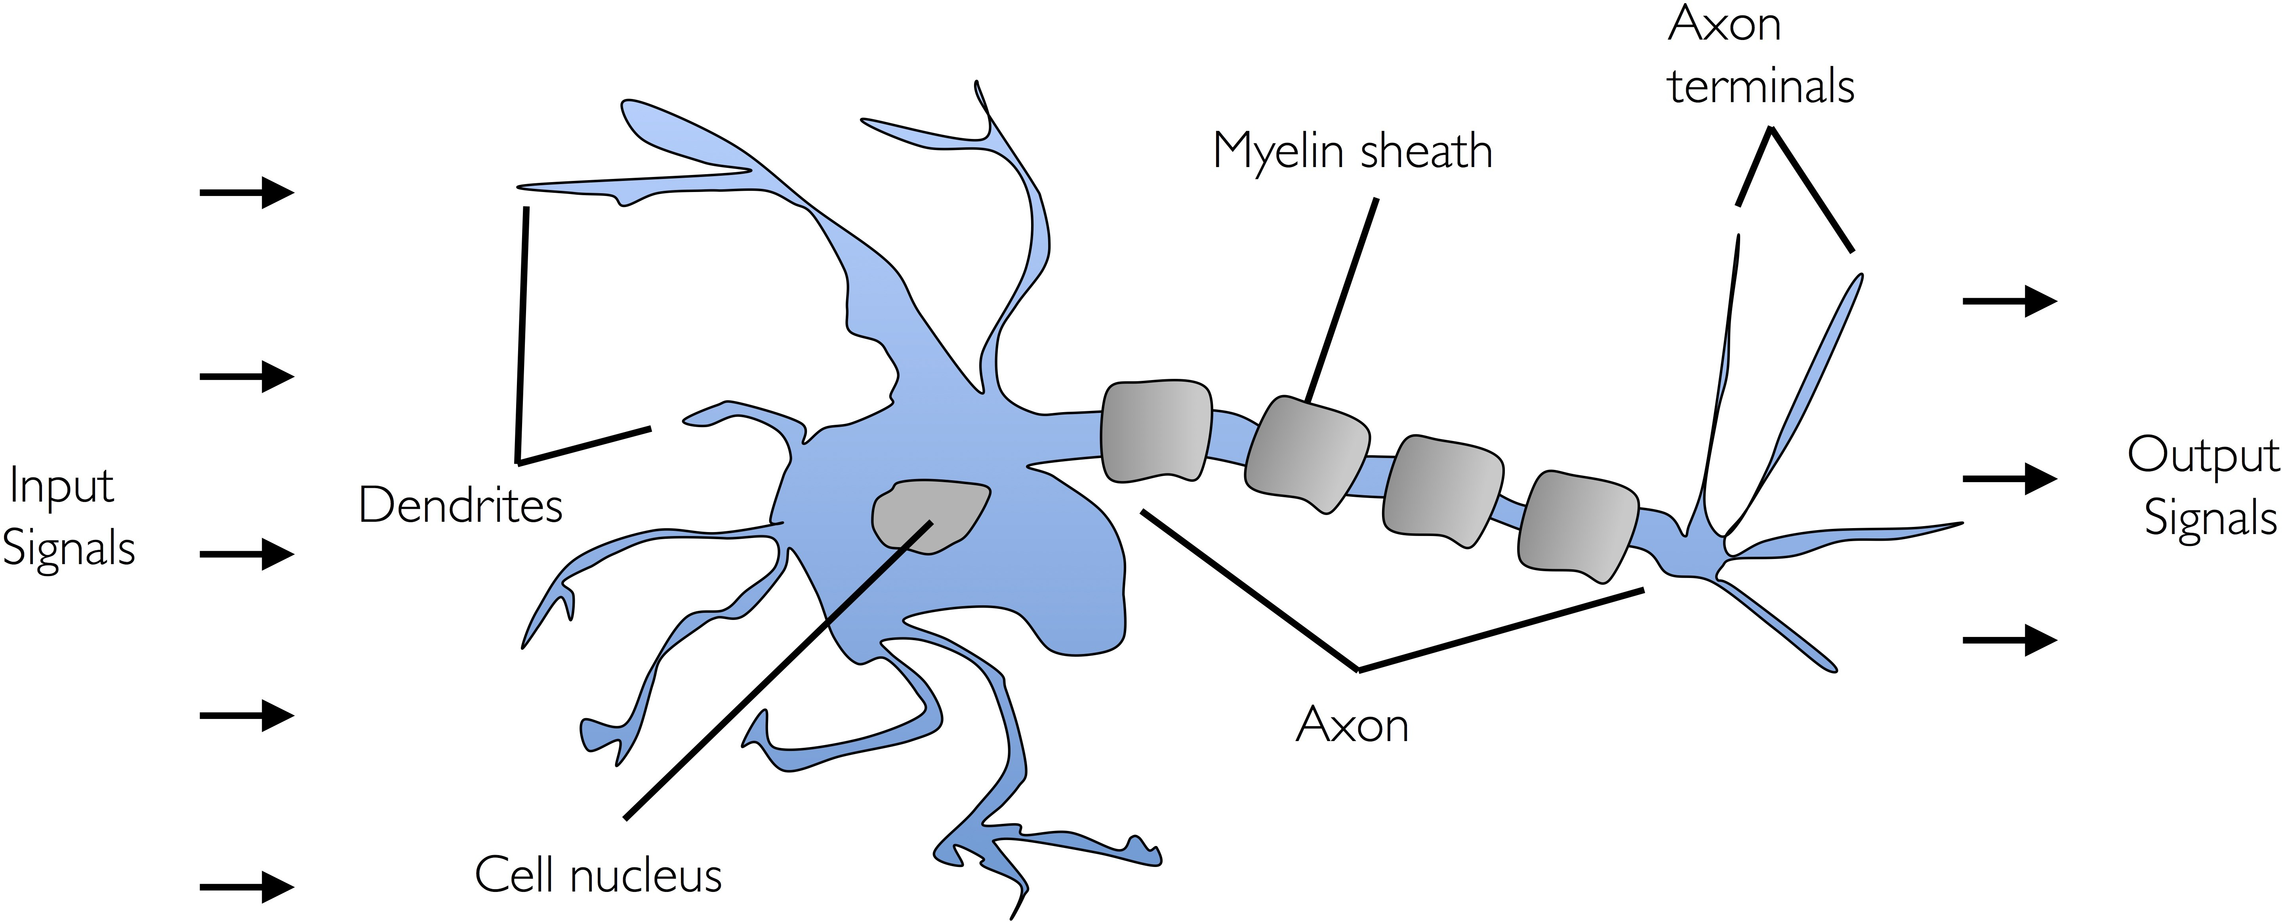
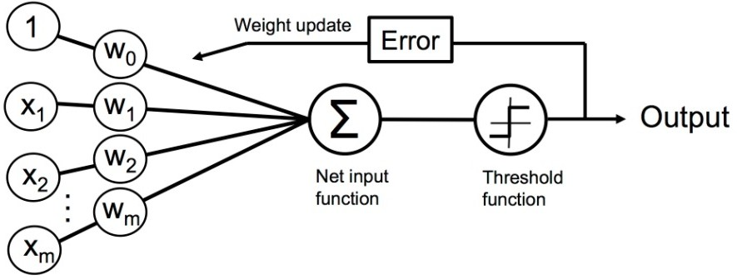
Recall: Perceptron
Biological Neuron:
Artificial Neurons (e.g., Perceptron):

Slide 5
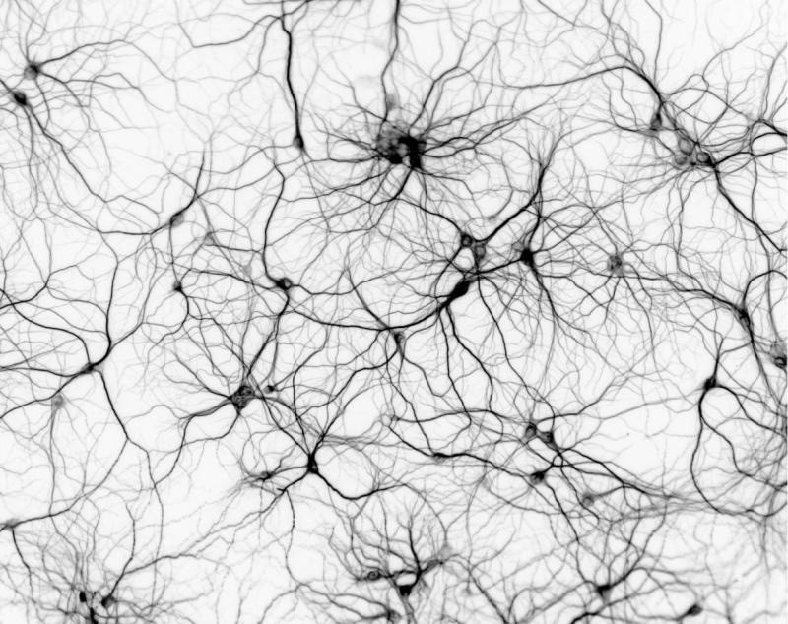
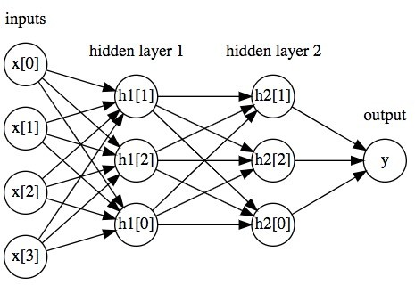
Neural Networks: Connected Neurons
Biological Neural Network:
Artificial Neural Network:

Slide 6
Hidden Layers
The training examples specify directly what the output layer must do at each point x; it must produce a value that is close to y.
The behavior of the other layers is not directly speciﬁed by the training data. The learning algorithm must decide how to use those layers to produce the desired output, but the training data do not say what each individual layer should do.
Because the training data does not show the desired output for each of these layers, they are called hidden layers.

Slide 7
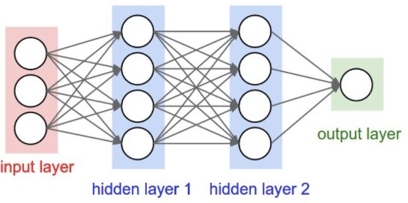
Neural Network
one input per feature
prediction
This is a 3-layer neural network (i.e., count number of hidden layers plus output layer)
each “hidden layer” uses outputs of units (i.e., neurons) and provides them as inputs to other units (i.e., neurons)

Slide 8
Neural Network
How does this relate to a perceptron?
Unit: takes as input a weighted sum and applies an activation function

Slide 9
Neural Network
How does this relate to a perceptron?
Unit: takes as input a weighted sum and applies an activation function

Slide 10
Neural Network
How does this relate to a perceptron?
Unit: takes as input a weighted sum and applies an activation function

Slide 11
Neural Network
How does this relate to a perceptron?
Unit: takes as input a weighted sum and applies an activation function

Slide 12
Neural Network
How does this relate to a perceptron?
Unit: takes as input a weighted sum and applies an activation function

Slide 13
Neural Network
How does this relate to a perceptron?
Unit: takes as input a weighted sum and applies an activation function

Slide 14
Neural Network
How does this relate to a perceptron?
Unit: takes as input a weighted sum and applies an activation function

Slide 15
Neural Network
How does this relate to a perceptron?
Unit: takes as input a weighted sum and applies an activation function

Slide 16
Neural Network
How does this relate to a perceptron?
Unit: takes as input a weighted sum and applies an activation function

Slide 17
Neural Network
Training goal: learn model parameters
Layers are called “hidden” because algorithm decides how to use each layer to produce its output

Slide 18
Neural Network
How many weights are in this model?
Input to Hidden Layer 1:
3x4 = 12
Hidden Layer 1 to Hidden Layer 2:
4x4 = 16
Hidden Layer 2 to Output Layer
4x1 = 4
Total:
12 + 16 + 4 = 32

Slide 19
Neural Network
How many parameters are there to learn?
Number of weights:
32
Number of biases:
4 + 4 + 1 = 9
Total
41

Slide 20
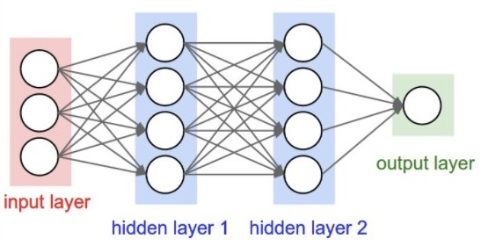
Fully Connected, Feedforward Neural Networks
What does it mean for a model to be fully connected?
Each unit provides input to each unit in the next layer
What does it mean for a model to be feedforward?
Each layer serves as input to the next layer with no loops

Slide 21
Backpropagation

Slide 22




Historical Context: Backpropagation
1957
1847
1945 1950
1956
1959
1986
2012
First programmable machine
Turing test
AI
Perceptron
Machine learning
Backpropagation for training neural networks
Wave 3: rise of “deep learning”
Gradient descent
D. Rulhart, G. Hinton, and R. Williams, Learning Internal Representations by Error Propagation, 1986.

Slide 23
What to Learn in Neural Network?
1
1
b₁
Learn:
weights connecting units
bias for each unit
x
^{W}11
h
b₃
o₁
1
1
w
W
21
21
W
12
x₂
h₂
w
21
e.g., 2 layer neural network:
^{W}22
1
b₂

Slide 24
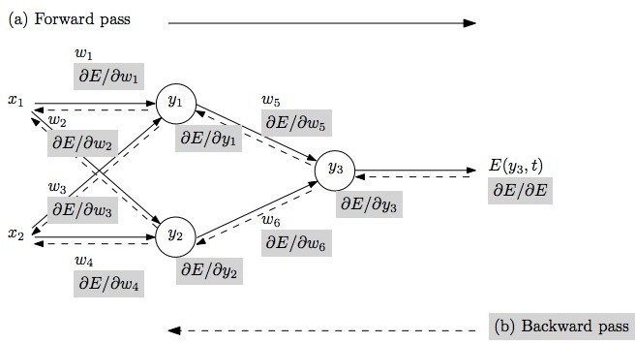
Training: How Neural Networks Learn
Repeat until stopping criterion met:
Forward pass: propagate training data through model to make prediction
Quantify the dissatisfaction with a model’s results on the training data
Backward pass: using predicted output, calculate gradients backward to assign blame to each model parameter
Update each parameter using calculated gradients
Objective/loss function used to compute error

Slide 25
When to Stop Training Neural Networks?
What stopping criterion to use?
Weight changes are incredibly small
Finished a pre-specified number of epochs
Percentage of misclassified example is below some threshold
…

Slide 26
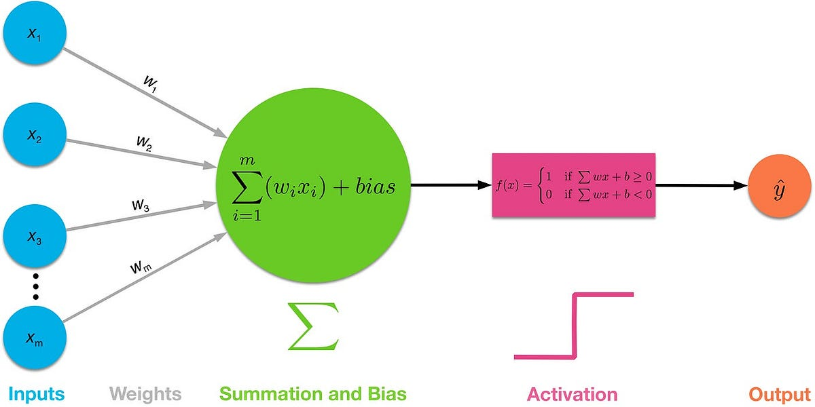
Activation Function

Slide 27
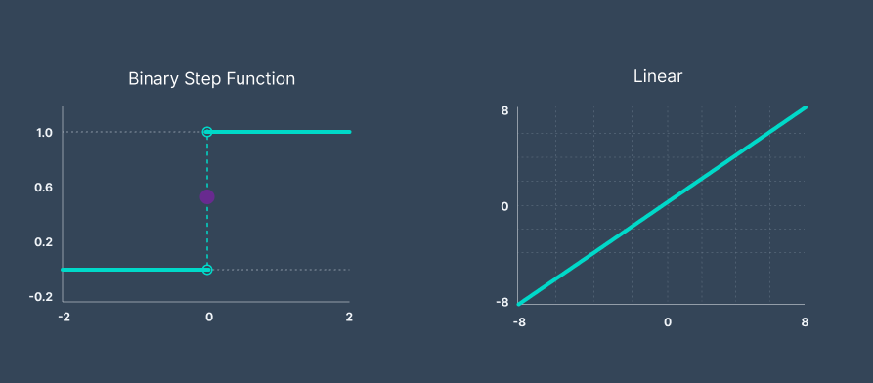
Linear Activation Function

Slide 28
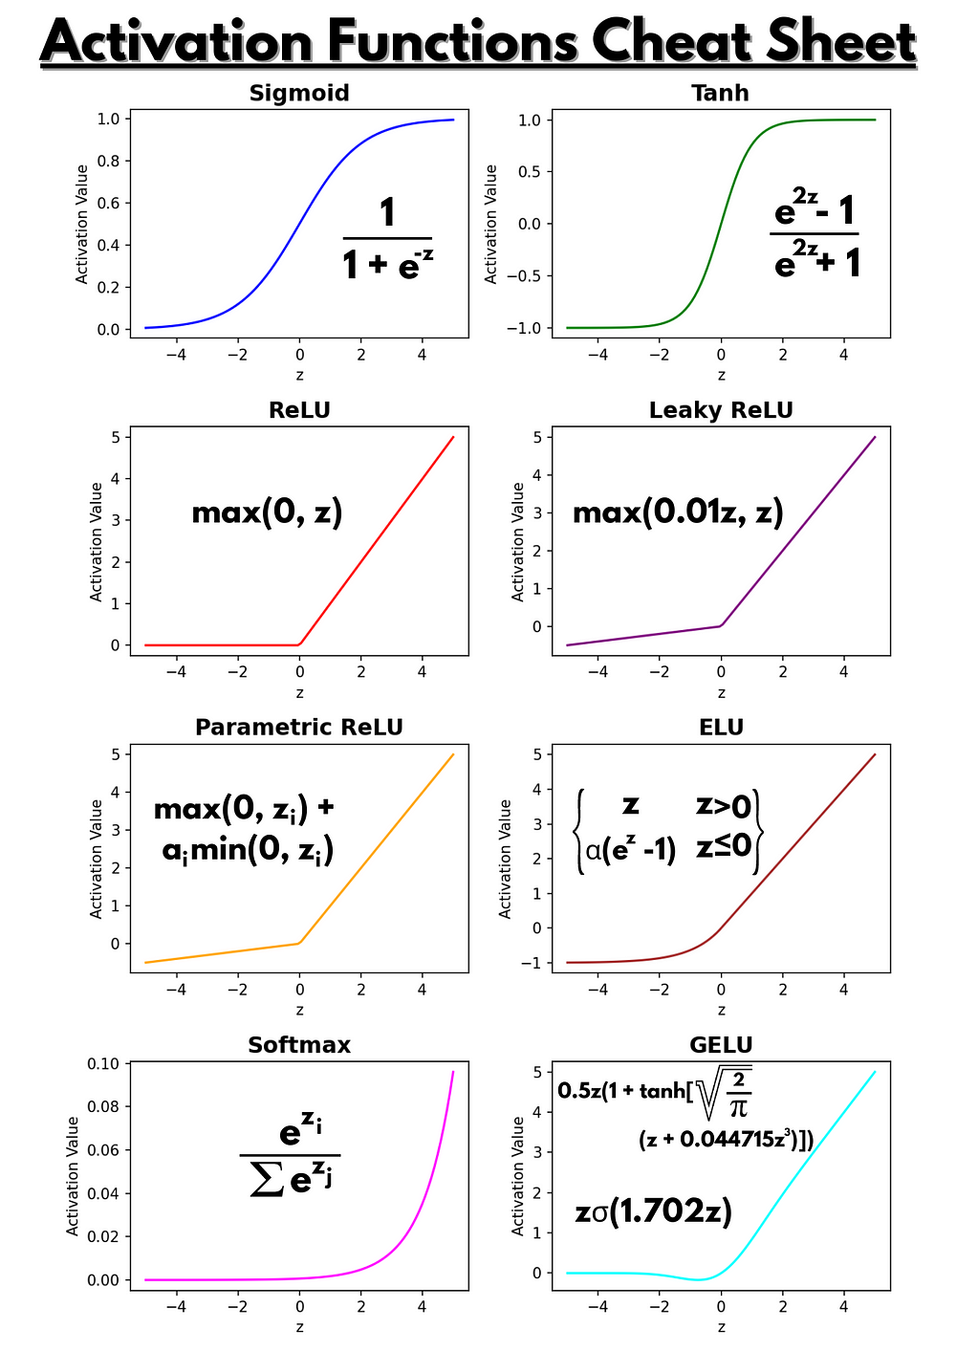
Non-Linear Activation Functions

Slide 29


